Slide 1



Statistical Analysis and Learning (SAL): Linear Regression (ISL Ch3, part 1) Textbook: An Introduction to Statistical Learning (ISL)
Varun Rai
LBJ School of Public Affairs
The University of Texas at Austin
31 January 2018

Slide 2
Note on Material
Unless otherwise noted, all material in this presentation are from this course’s textbook, An Introduction to Statistical Learning (ISL)

Slide 3
Linear Regression
Notes:
Begin session 1

Slide 4
Linear Regression
This unit is about linear regression, a very simple approach for supervised learning. In particular, linear regression is a useful tool for predicting a quantitative response.
Linear regression is a widely used statistical learning method. Moreover, it serves as a good jumping-off point for newer approaches: as we will see in later units, many fancy statistical learning approaches can be seen as generalizations or extensions of linear regression.
Consequently, the importance of having a good understanding of linear regression before studying more complex learning methods cannot be overstated.
In this unit, we review some of the key ideas underlying the linear regression model, as well as the least squares approach that is most commonly used to fit this model.

Slide 5
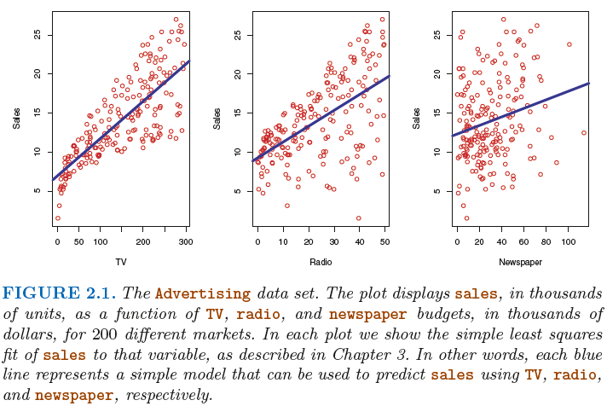
Inference Problem: Advertising Example Which advertising strategy will lead to higher product sales next year?
One may be interested in answering questions such as:
– Which media contribute to sales?
– Which media generate the biggest boost in sales? or
– How much increase in sales is associated with a given increase in TV advertising?

Slide 6
Additional Questions of Interest Which advertising strategy will lead to higher product sales next year?
Is there a relationship between advertising budget and sales?
How strong is the relationship between advertising budget and sales?
Which media contribute to sales?
How accurately can we estimate the effect of each medium on sales?
How accurately can we predict future sales?
Is the relationship linear?
Is there synergy among the advertising media?

Slide 7
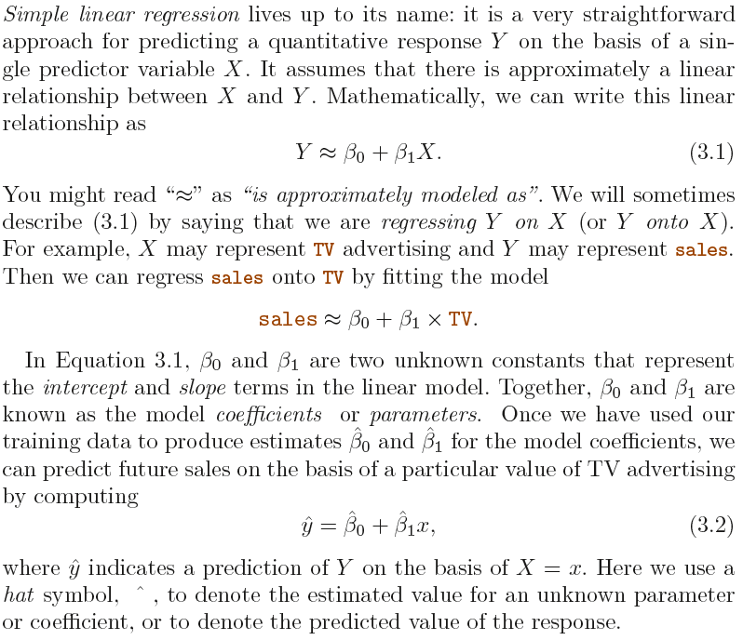
Simple Linear Regression
Notes:
We interpret beta_j as the average effect on Y of a one unit
increase in Xj.

Slide 8
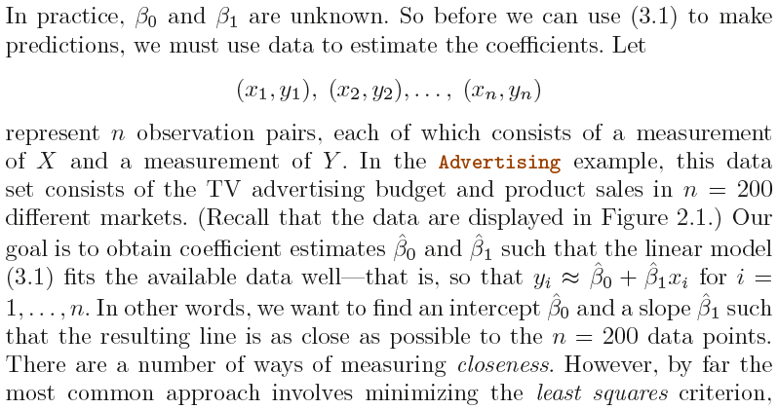
Estimating the Coefficients

Slide 9
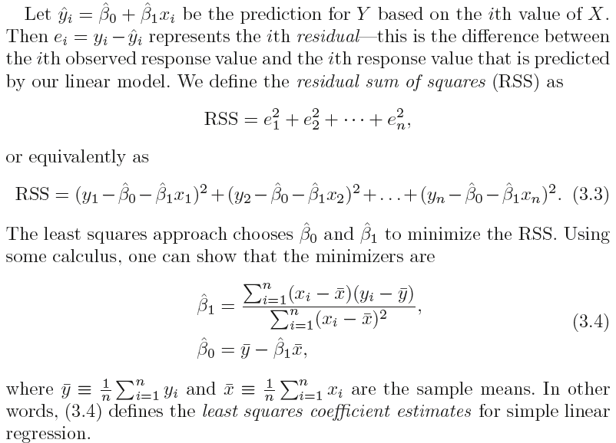
Estimating the Coefficients, cntd...

Slide 10
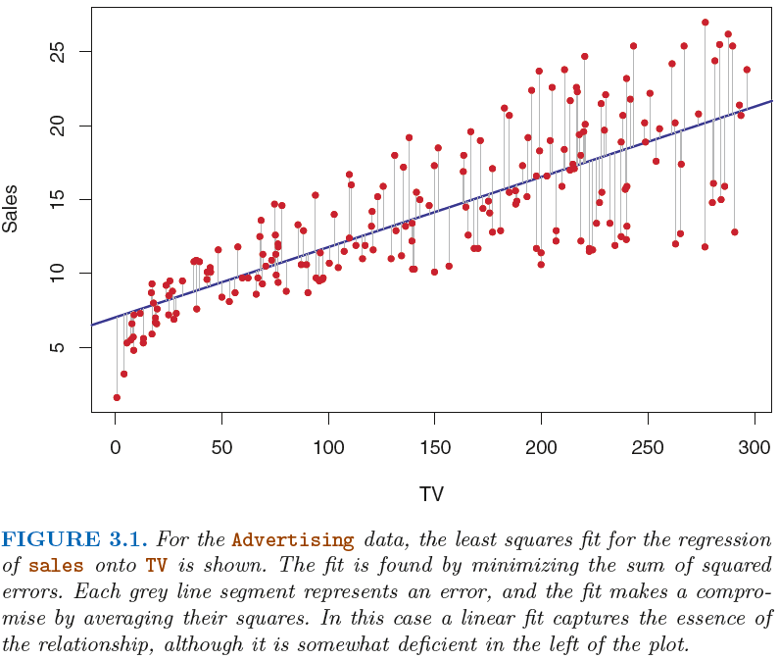
Least Squares Estimation

Slide 11

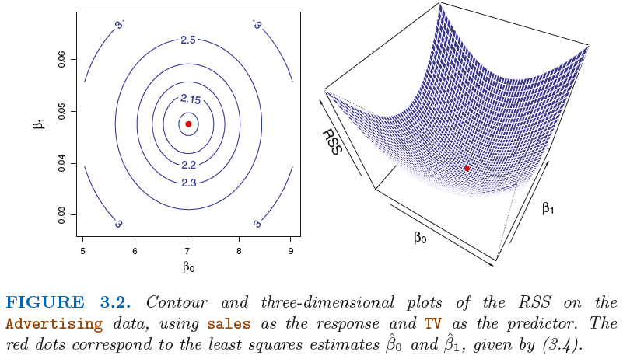
Least Squares Estimation

Slide 12
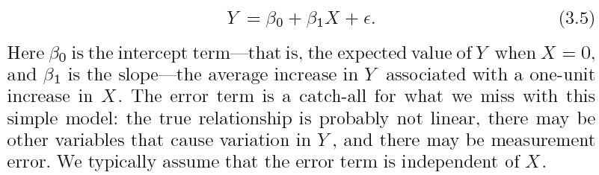
Accuracy of the Estimated Coefficients
Population regression line
Population regression line: The best linear approximation of the true
relationship between Y and X.
contrast with
least squares line: obtained by fitting a line to the sample using the
method of least squares.

Slide 13
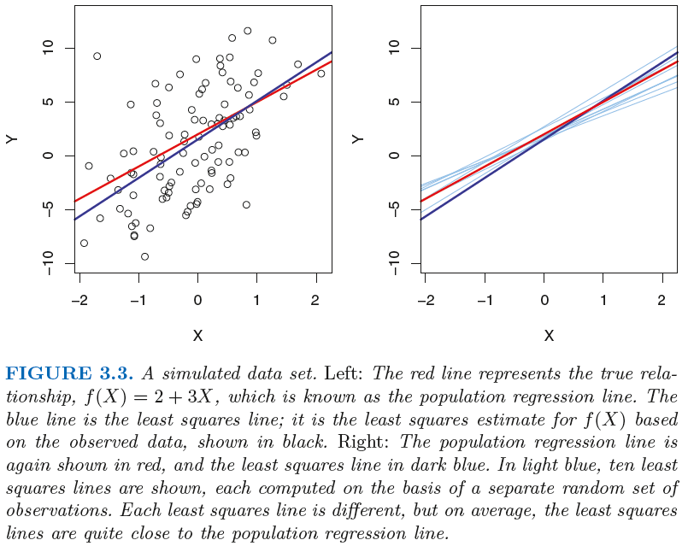

Accuracy of the Estimated Coefficients, cntd
10 samples

Slide 14
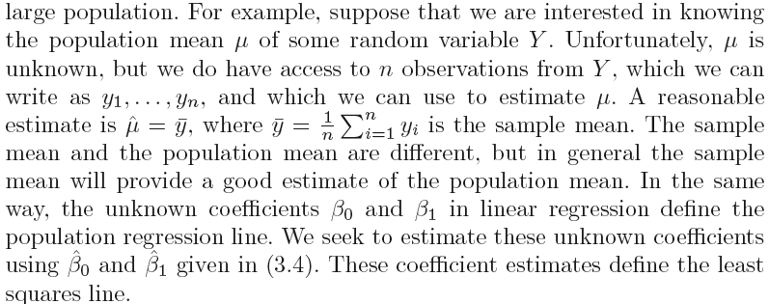
Let’s Go Back to Statistics 101 For a Moment
We only have one data set, and so what does it mean that two different lines describe the relationship between the predictor and the response?
Fundamentally, the concept of these two lines is a natural extension of the standard statistical approach of using information from a sample to estimate characteristics of a large population.

Slide 15
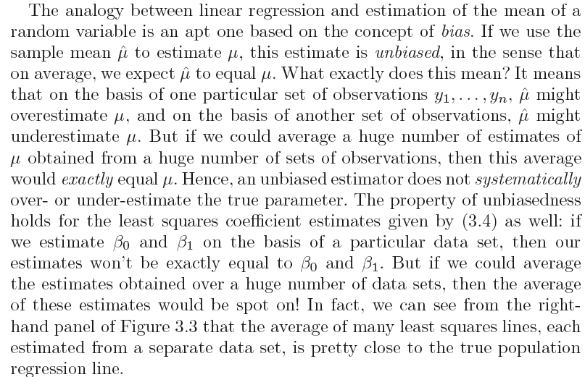
Unbiased Estimates

Slide 16
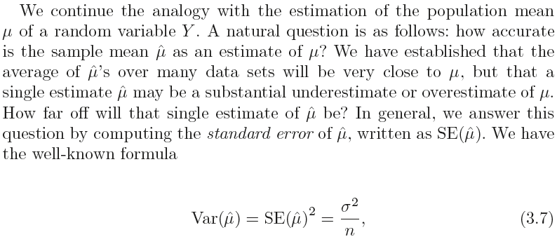
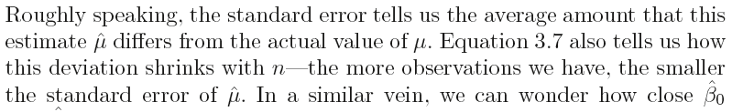
How Accurate is the Sample Mean as an Estimate of True Mean?

Slide 17
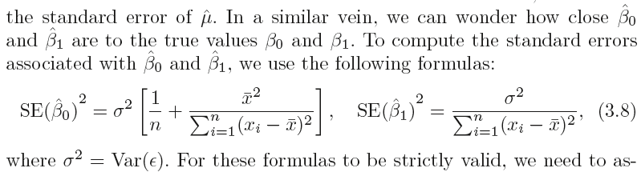
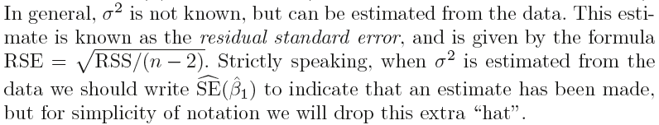
Standard Errors for OLS Estimates
Notes:
Epsilon is the stochastic error term in equation 3.5, which represents the population regression line (PRL).

Slide 18
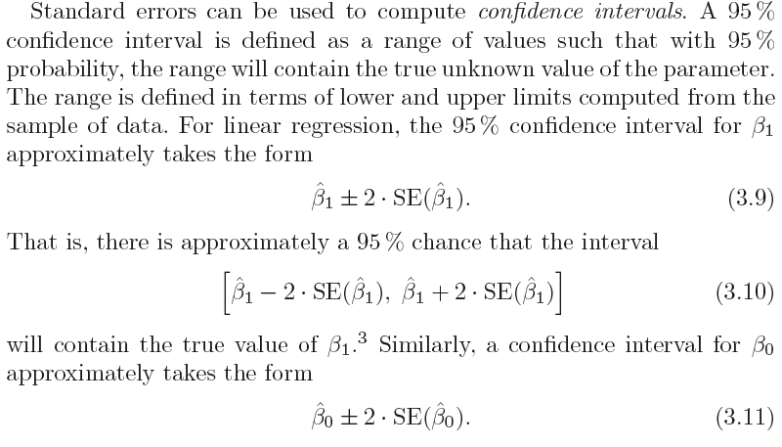
Confidence Intervals

Slide 19
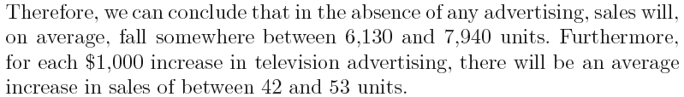
Confidence Intervals: Back to Advertising
Notes:
End session 1

Slide 20
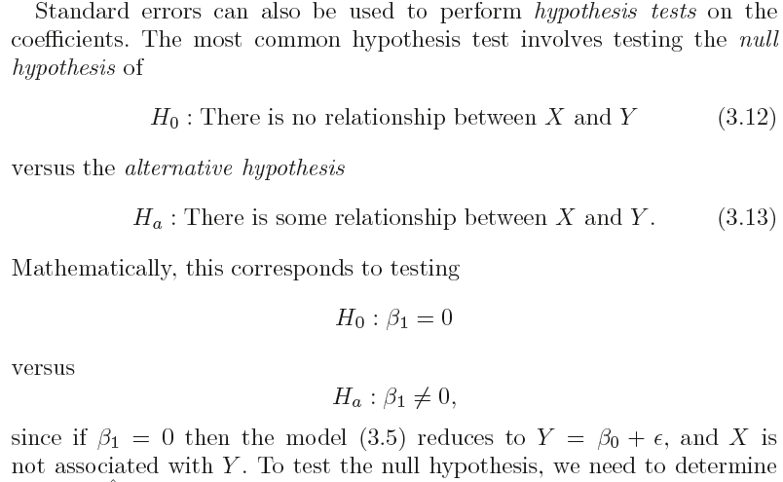
Standard Errors and Hypothesis Testing
Notes:
Begin session 2

Slide 21
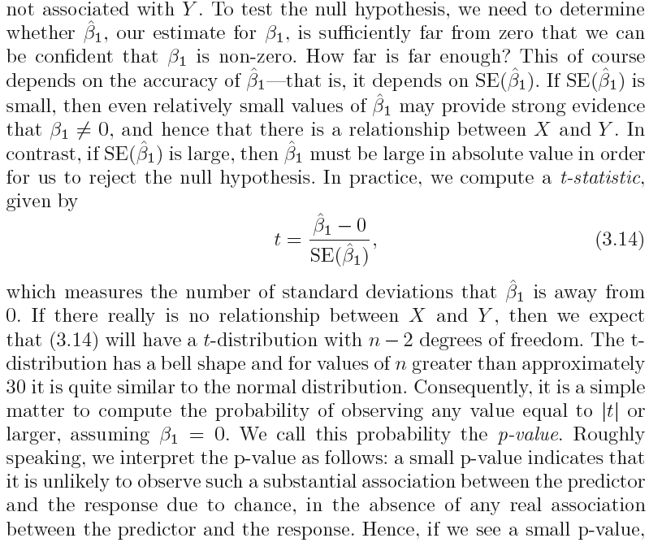
Standard Errors and Hypothesis Testing, cntd

Slide 22
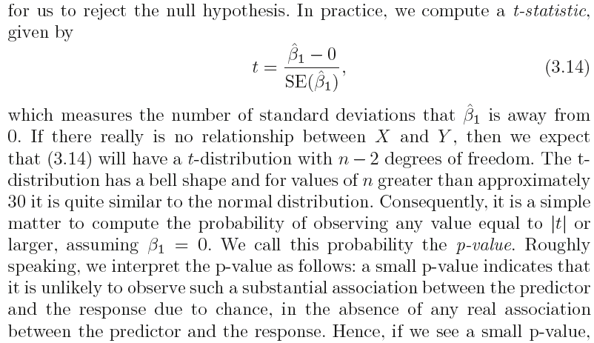
Standard Errors and Hypothesis Testing, cntd
Notes:
SE(beta1_hat) is the estimated SE using the estimated value of sigma^2.
Assumes that the error term is normally distributed.
n-2 because two degrees of freedom are lost in estimating beta_1 and beta_0.

Slide 23
p-values, small enough?
If we see a small p-value, then we can infer that there is an association between the predictor and the response.
We reject the null hypothesis —that is, we declare a relationship to exist between X and Y —if the p-value is small enough.
Typical p-value cutoffs for rejecting the null hypothesis are 5 or 1%. When n = 30, these correspond to t-statistics of around 2 and 2.75, respectively.

Slide 24
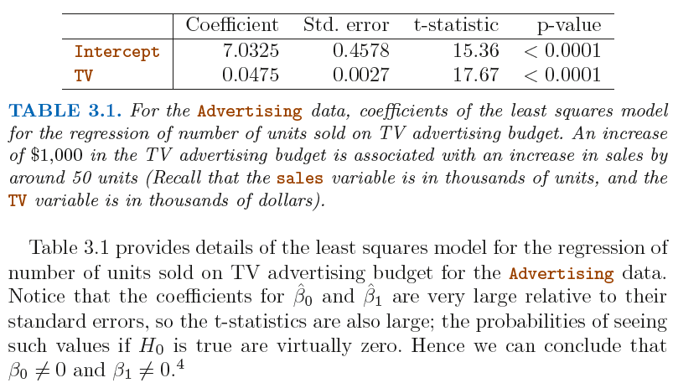
Hypothesis Testing: Back to Advertising

Slide 25
Accuracy of the Model: How Well the Model Fits the Data? RSE, R² statistic, and F-statistic

Slide 26
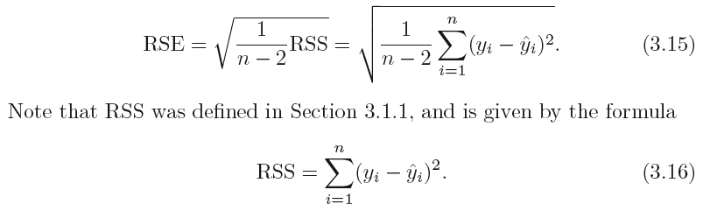
Residual Standard Error (RSE)
The RSE is an estimate of the standard deviation of ε. Roughly speaking, it is the average amount that the response will deviate from the true regression line. It is computed using the formula
What are the units of RSE?
Notes:
n-2 because two degrees of freedom are lost in estimating beta_1 and beta_0.

Slide 27
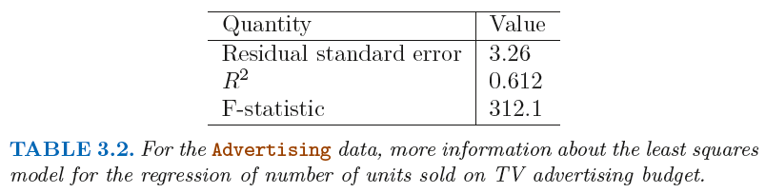
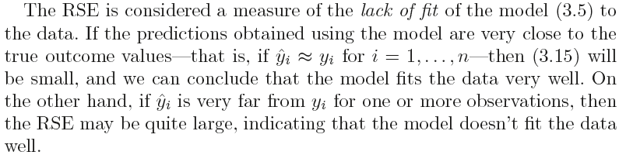
Residual Standard Error (RSE): Advertising
The RSE is 3.26. In other words, actual sales in each market deviate from the true regression line by approximately 3,260 units, on average.
In the advertising data set, the mean value of sales over all markets is approximately 14, 000 units, and so the percentage error is 3, 260/ 14, 000 = 23%.

Slide 28
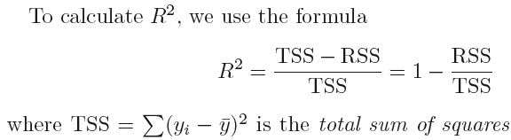
R² Statistic
The RSE provides an absolute measure of lack of fit of the model to the data. But since it is measured in the units of Y, it is not always clear what constitutes a good RSE.
The R² statistic provides an alternative measure of fit. It takes the form of a proportion —the proportion of variance explained—and so it always takes on a value between 0 and 1, and is independent of the scale of Y.
TSS measures the total variance in the response Y, and can be thought of as the amount of variability inherent in the response before the regression is performed.

Slide 29
R² Statistic
R² measures the proportion of variability in Y that can be explained using X.
An R² statistic that is close to 1 indicates that a large proportion of the variability in the response has been explained by the regression.
A number near 0 indicates that the regression did not explain much of the variability in the response; this might occur because the linear model is wrong, or the inherent error σ² is high, or both.
In the advertising example, the R² was 0 .61, and so just under two-thirds of the variability in sales is explained by a linear regression on TV.
What is a good R² value?
Notes:
End session 2

Slide 30
Multiple Linear Regression
Notes:
Begin session 3

Slide 31
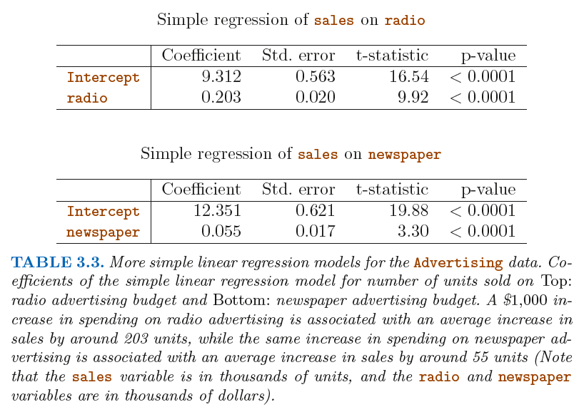
Multiple Linear Regression: More than 1 X

Slide 32
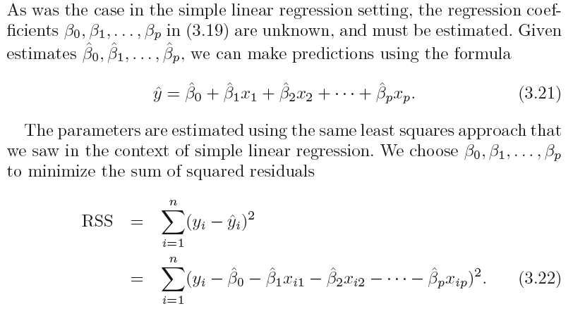
Estimating Coefficients in MLR
Notes:
We interpret beta_j as the average effect on Y of a one unit
increase in Xj , holding all other predictors fixed.

Slide 33
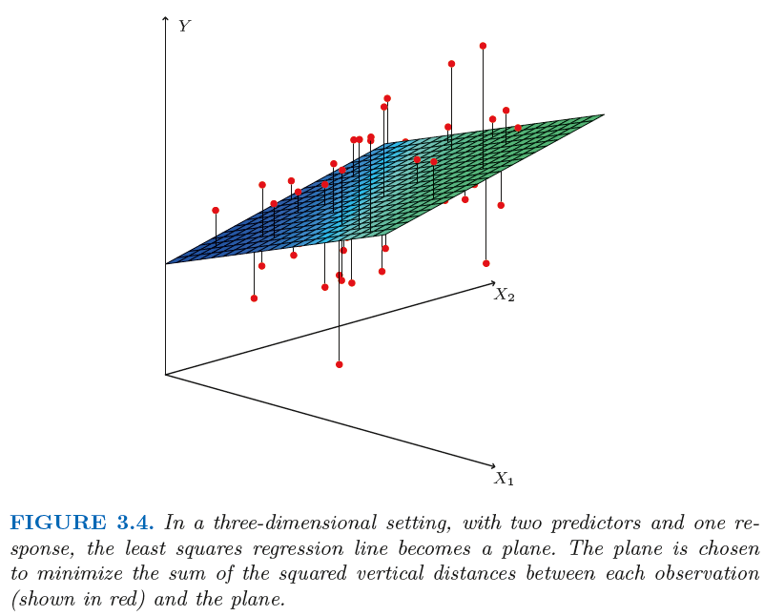
Multiple Linear Regression: More than 1 X
The values ˆβ0, ˆβ1, . . . , ˆ βp that minimize RSS are the multiple least squares regression coefficient estimates.
Any statistical software package (like R) can be used to compute these coefficient estimates.

Slide 34
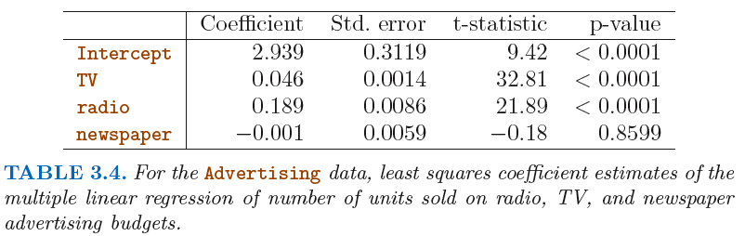
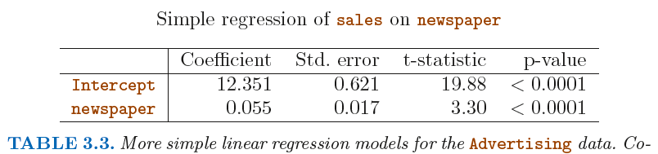
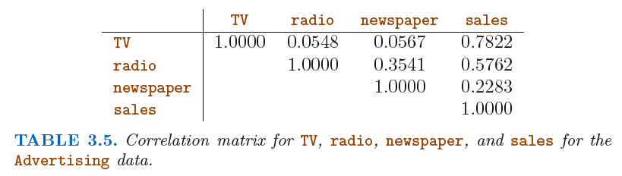
Multiple Linear Regression: Advertising

Slide 35
Some Important Questions in MLR
1. Is at least one of the predictors X1,X2, . . . , Xp useful in predicting the response?
Do all the predictors help to explain Y, or is only a subset of the predictors useful? (will skip now; covered in Chapter 6)
How well does the model fit the data?
4. Given a set of predictor values, what response value should we predict, and how accurate is our prediction?

Slide 36
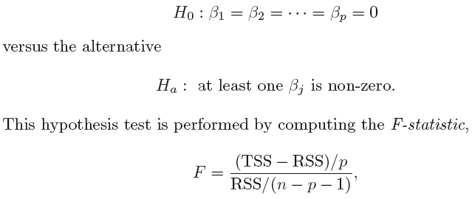


Is There a Relationship Between the Response and Predictors?
In the simple linear regression setting, in order to determine whether there is a relationship between the response and the predictor we can simply check whether β1 = 0. In the multiple regression setting with p predictors, we need to ask whether all of the regression coefficients are zero, i.e. whether β1 = β2 =...= βp = 0. As in the simple linear regression setting, we use a hypothesis test to answer this question. We test the null hypothesis,

Slide 37
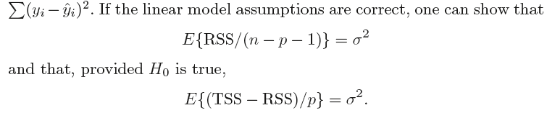
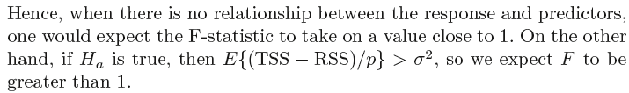
F Statistic

Slide 38
F Statistic
How large does the F-statistic need to be before we can reject H₀ and conclude that there is a relationship?
It turns out that the answer depends on the values of n and p .
When n is large, an F-statistic that is just a little larger than 1 might still provide evidence against H₀.
In contrast, a larger F-statistic is needed to reject H₀ if n is small.
When H₀ is true and the errors ε_{i} have a normal distribution, the F-statistic follows an F-distribution.
For any given value of n and p , any statistical software package can be used to compute the p-value associated with the F-statistic using this distribution.
Based on this p-value, we can determine whether or not to reject H₀.

Slide 39
Why calculate the F-Statistic? Is it not enough that the individual p-values for the β’s are (very) small?
NO!
Especially for large p, in which case just by chance one or more of the p-values might be very small, even if there is no true relationship between the predictor(s) and the response!
The F-statistic does not suffer from this problem because it adjusts for the number of predictors.
The approach of using an F-statistic to test for any association between the predictors and the response works when p is relatively small, and certainly small compared to n .

Slide 40
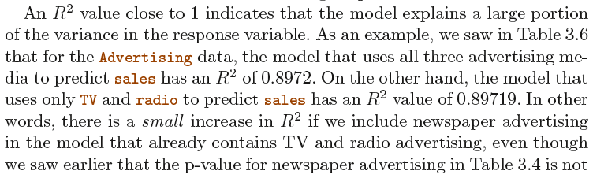
Model Fit in MLR
Two of the most common numerical measures of model fit are the RSE and R² , the fraction of variance explained. These quantities are computed and interpreted in the same fashion as for simple linear regression.
It turns out that R² will always increase when more variables are added to the model, even if those variables are only weakly associated with the response. WHY?

Slide 41
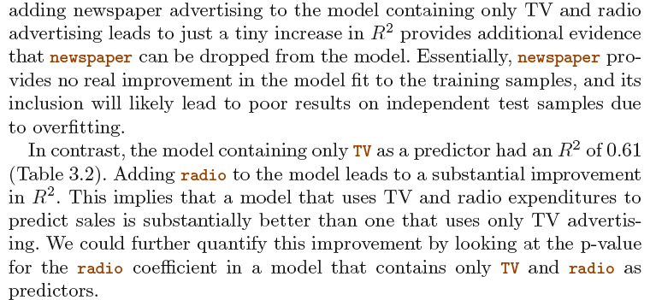

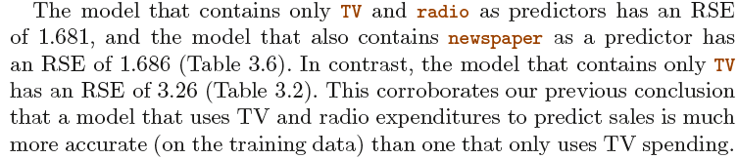
Model Fit in MLR: Advertising

Slide 42
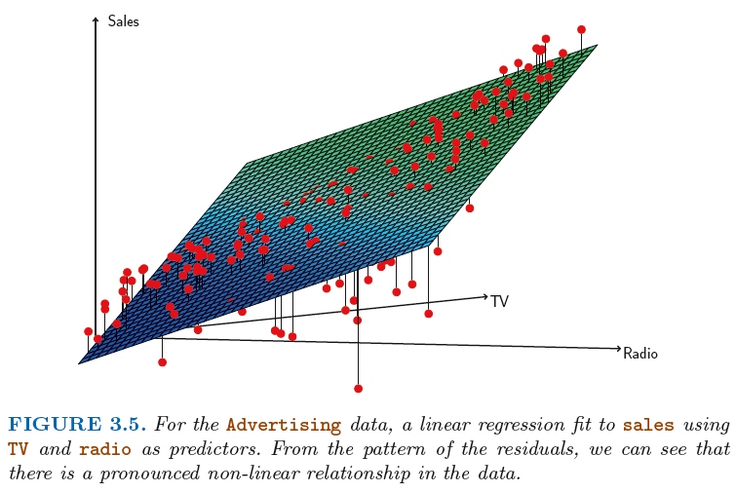
Model Fit in MLR: Visualizing the Errors

Slide 43

Predictions
Once we have fit the multiple regression model, it is straightforward to apply:
in order to predict the response Y on the basis of a set of values for the predictors X1,X2, . . . , Xp .
However, there are three sorts of uncertainty associated with this prediction:
Reducible error: sample vs. (true) population | use confidence interval
Model bias: linear model not good approx. for true f | Ignore now
Irreducible error: due to the random error term | use prediction interval
Prediction intervals are always wider than confidence intervals, because they incorporate both the error in the estimate for f (X ) (the reducible error) and the uncertainty as to how much an individual point will differ from the population regression plane (the irreducible error).

Slide 44
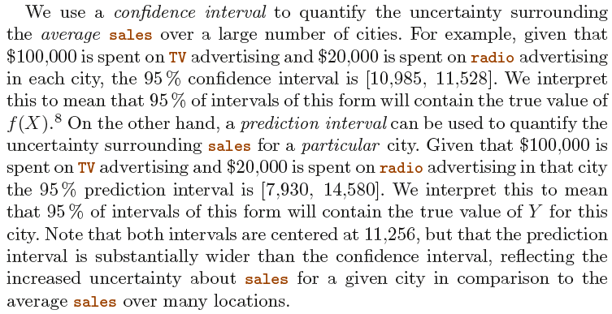
Confidence and Prediction Intervals

Slide 45
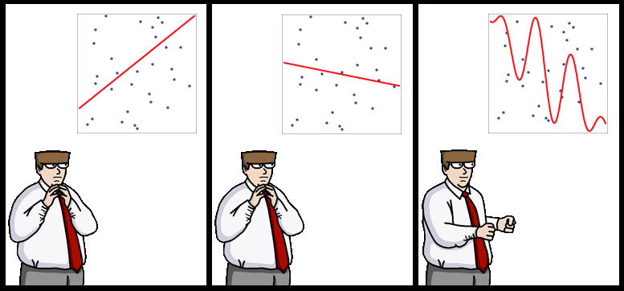
End of Lecture #3
Source: http://yaroslavvb.blogspot.com/

